Slide 1
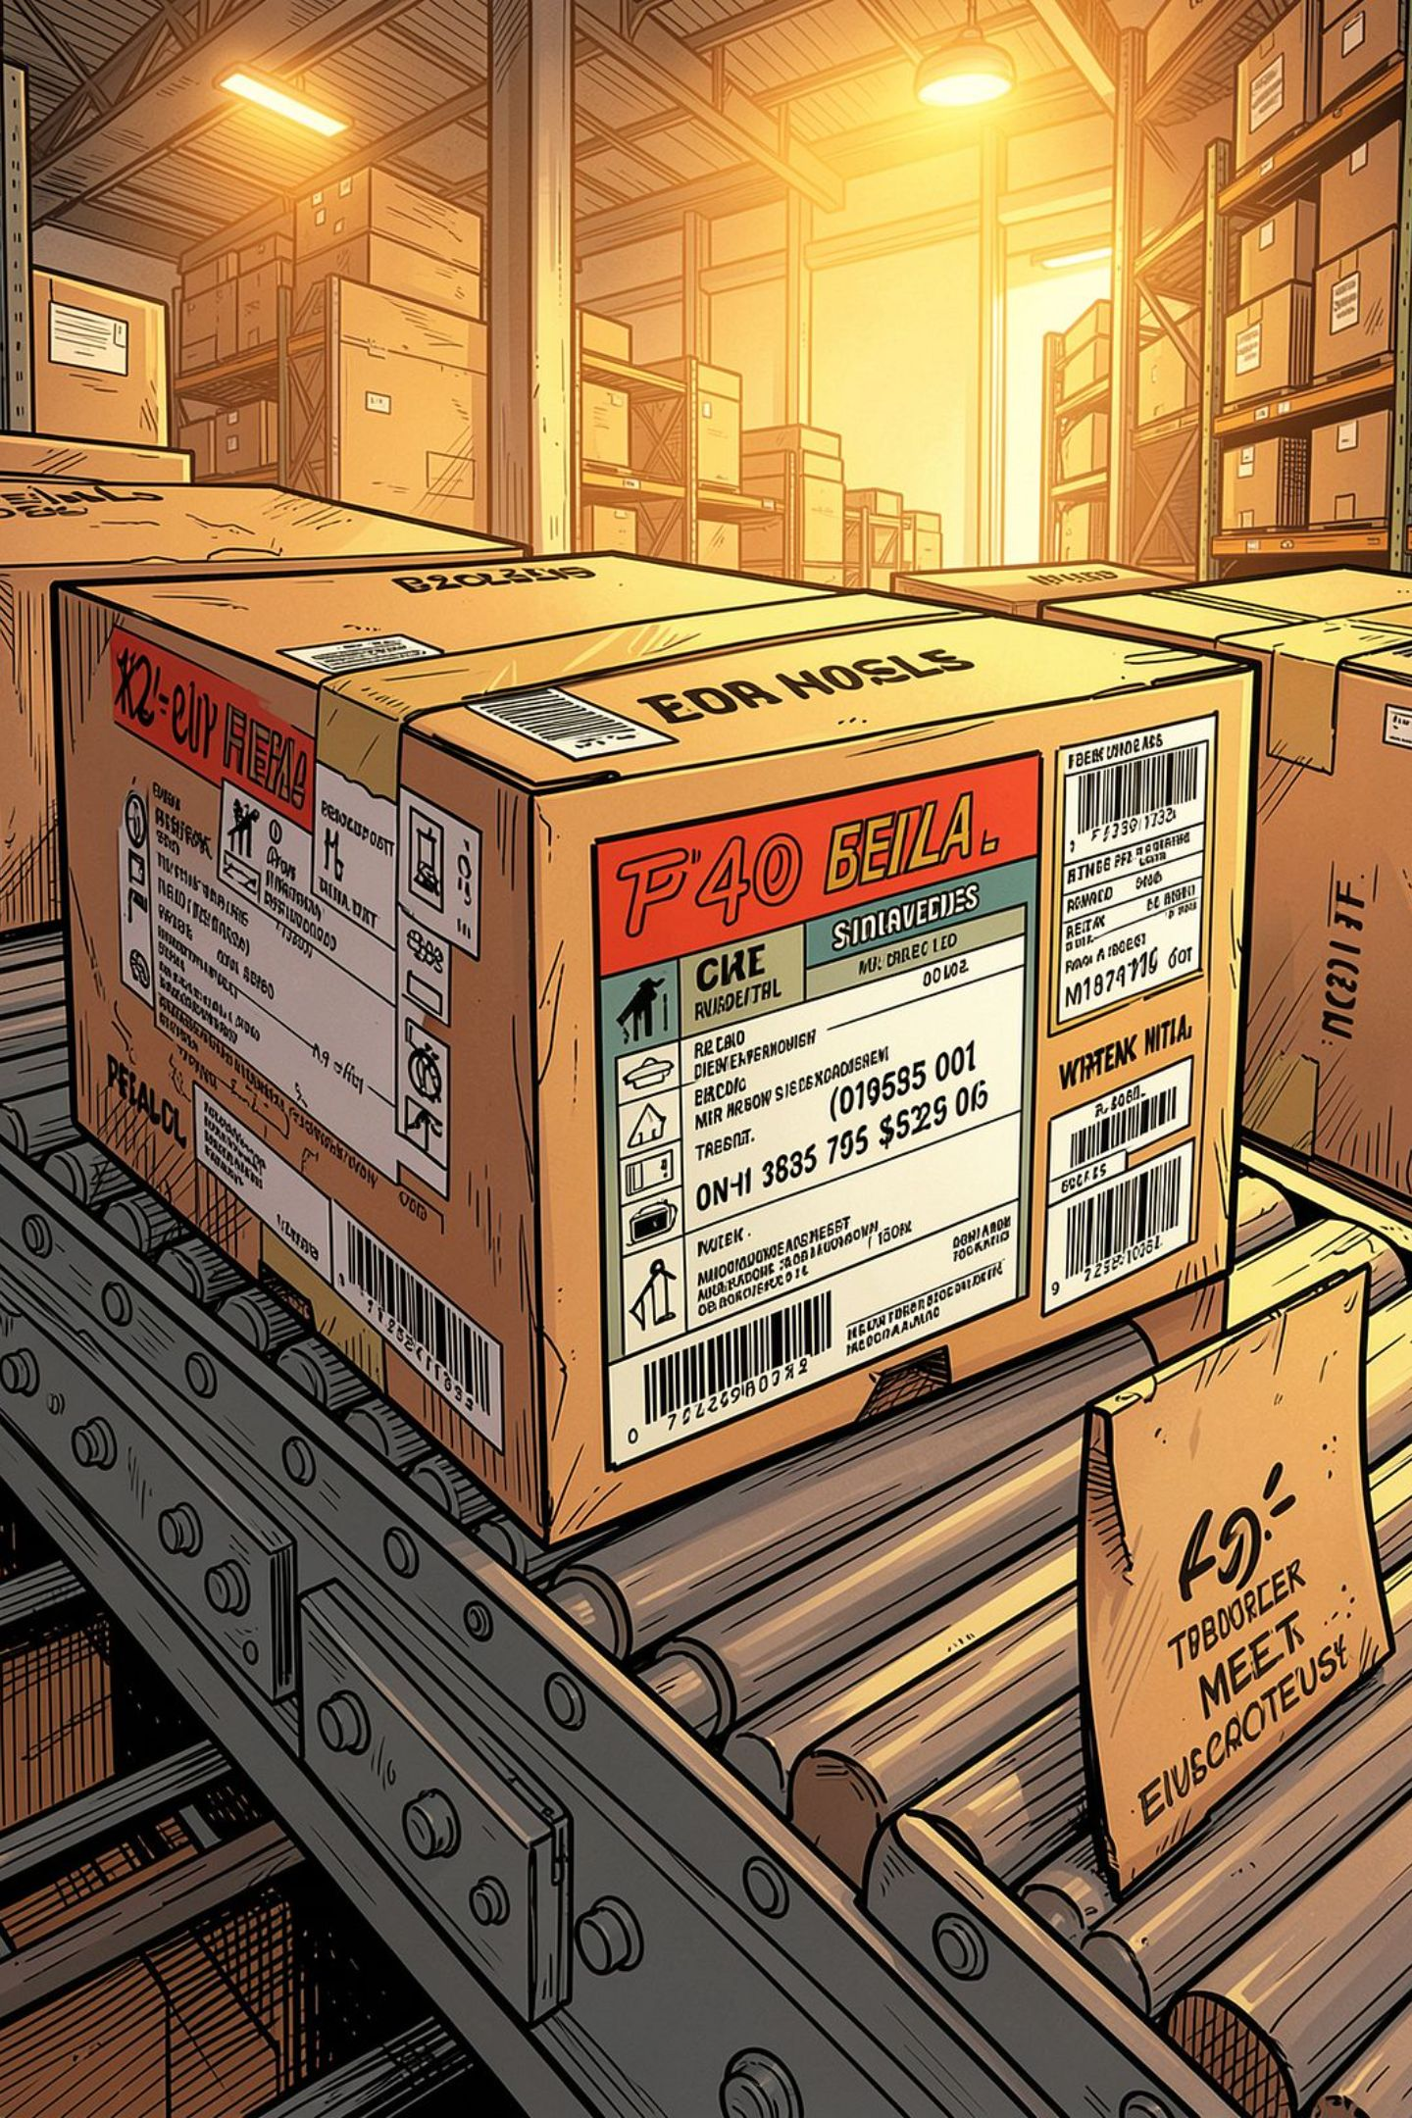
True Tag: Autonomous Label Verification
Scan_Detect_Verify

Slide 2
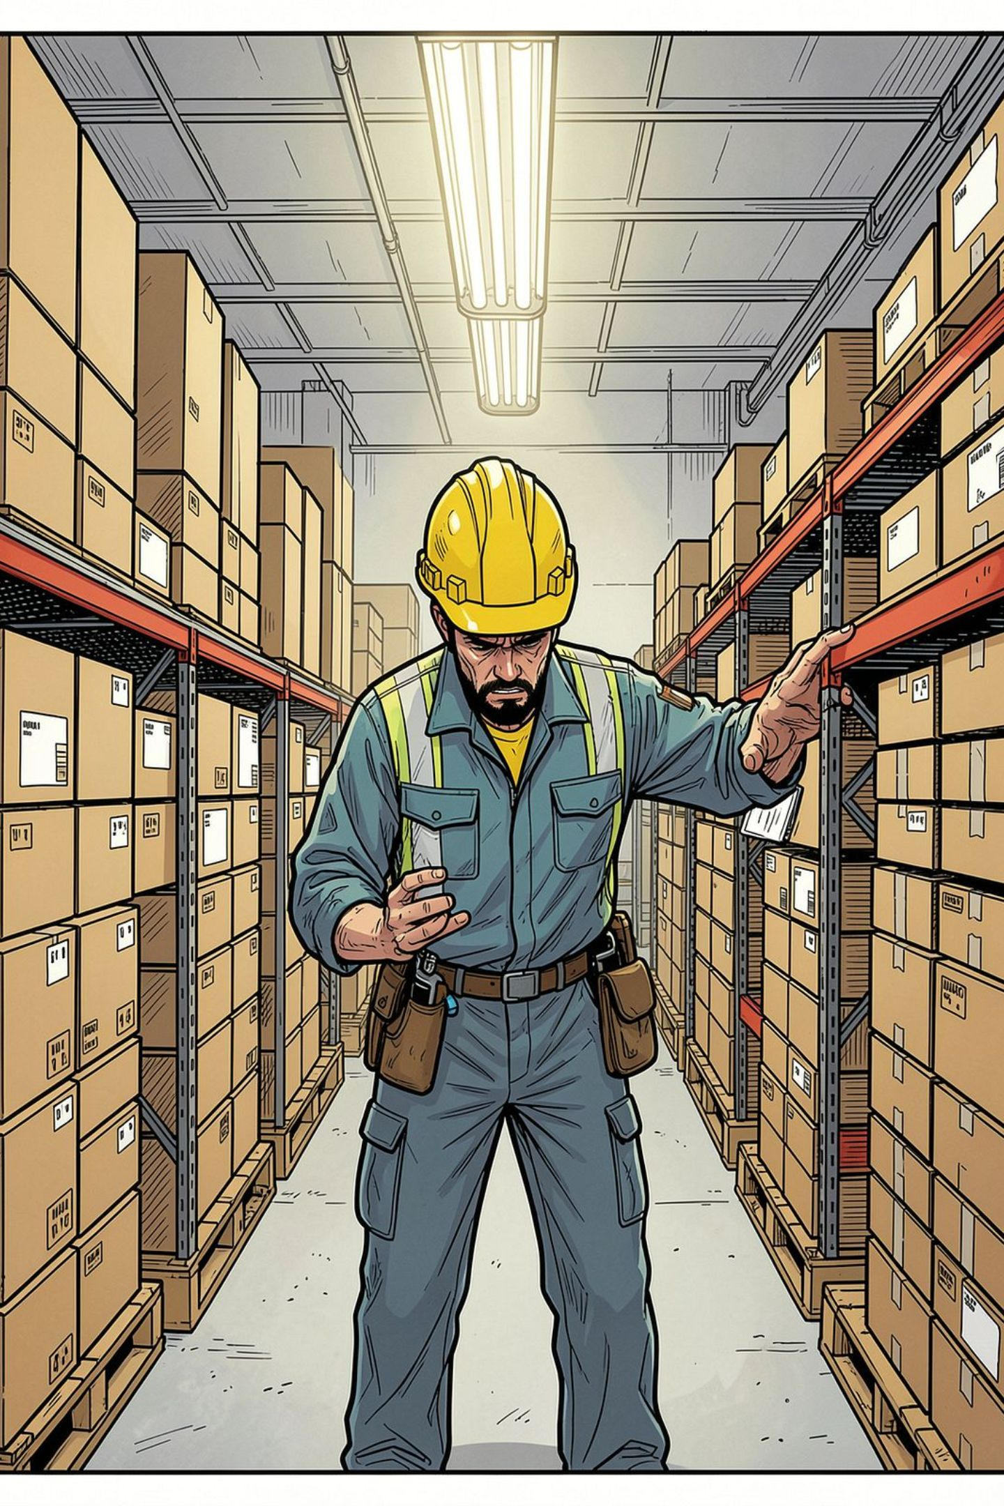
The Compliance Nightmare
Slow & Error Prone
Fine & Recalls
Manual packaging verification cannot keep pace with high volume SKU catalogs - human errors.
Violation of Legal Metrology Rules, 2011 expose sellers to regulatory fines and costly product recalls.
Scaling Is Impossible
E-commerce sellers managing thousand of SKUs cannot manually verify every label - gaps are inevitable

Slide 3
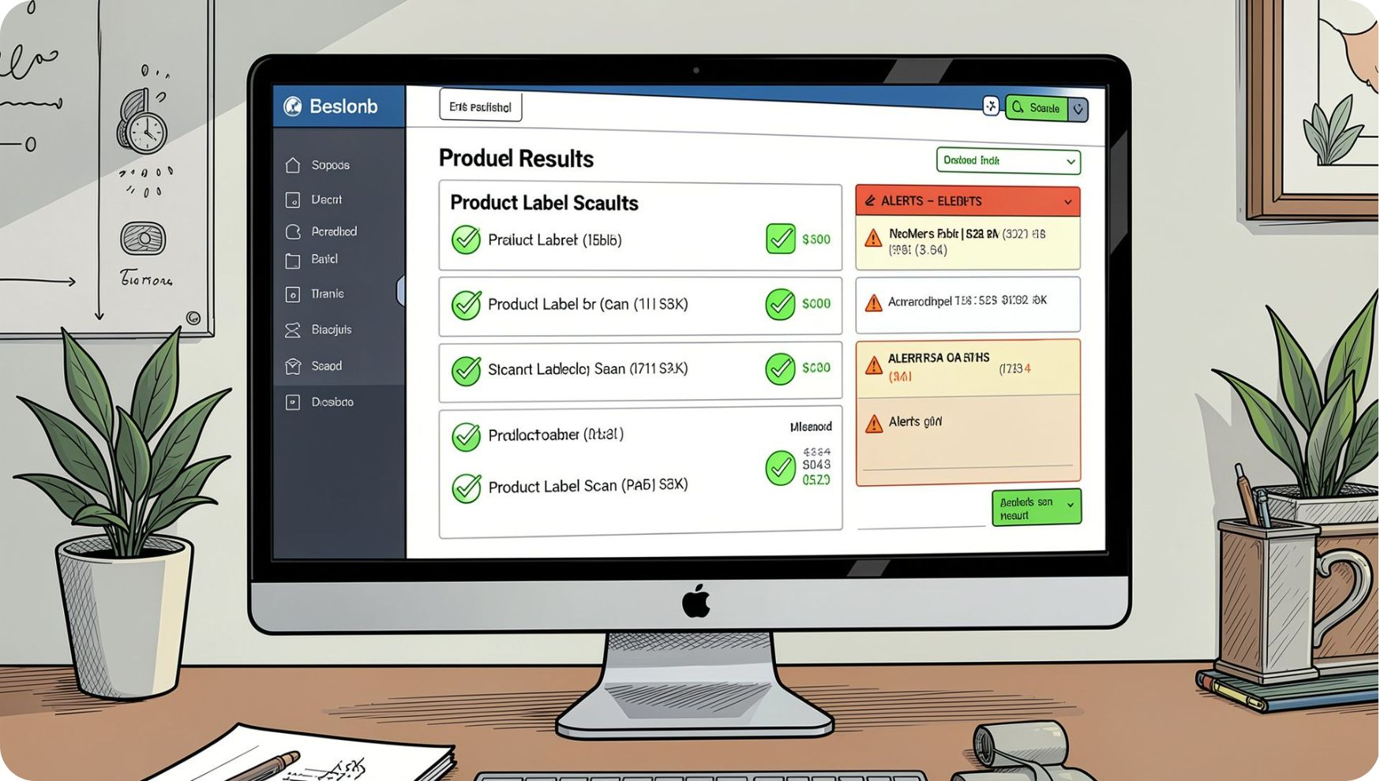
True Tag: Real-Time Automated Verification
Scans product packaging in seconds, flags violations instantly
Detects missing or incorrect MRP, net quantity, and manufacturer details
Integrates seamlessly into your existing QC workflows — zero disruption

Slide 4

How It Works: Vision-Driven Pipeline
OpenCV Processing
Image Capture
OCR & Validation
Each label is processed end-to-end in seconds — from raw image to compliance verdict — with no human intervention required.

Slide 5
Mandatory Declarations at Scale
MRP & Net Quantity
Dates & Batch Numbers
Automatically identifies, reads, and validates pricing and weight declarations against legal standards.
Flags missing expiry dates, manufacture dates, and batch codes before products leave the warehouse.
Real-Time Reports
Origin
Generates structured compliance audit reports instantly, ready for regulatory review or internal QC records.
Country of Origin

Slide 6
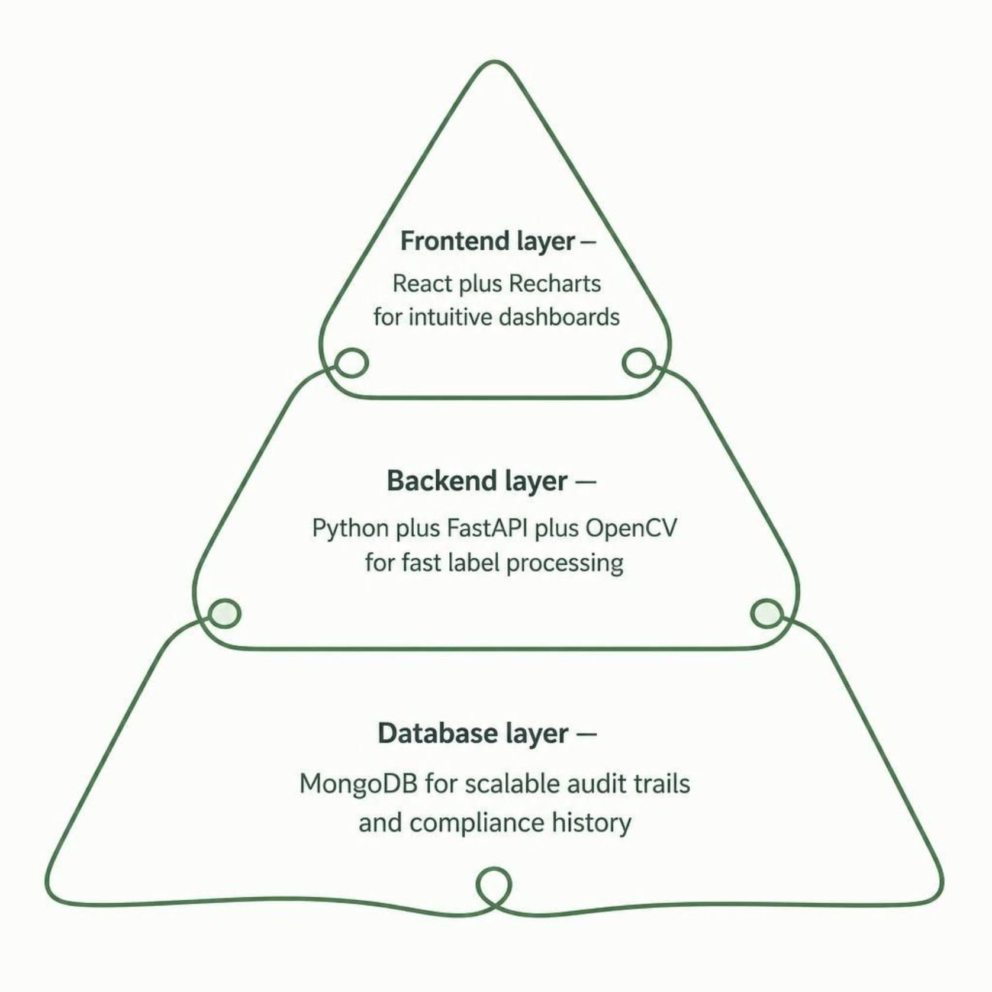
Built for Speed & Reliability
Enterprise-Grade Architecture
TrueTag is engineered for production environments — built on proven, battle-tested open-source technologies that scale with your catalog.
React + Recharts — intuitive compliance dashboards your team will actually use
Python + FastAPI + OpenCV — high-throughput image processing with sub-second response
MongoDB — scalable audit trail storage for every scan, every product, every decision

Slide 7


Story Time

